Slide 1
Longevity
Exercise is medicine

Slide 2
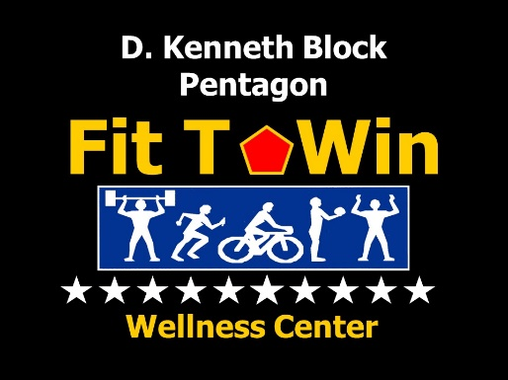
Christopher Fall LMT, CSCS, ACSM EP-C, CES
B.S. Kinesiology
Licensed Massage Therapist
NSCA - Certified Strength and Conditioning Coach
ACSM – Certified Exercise Physiologist
NASM - Corrective Exercise Specialist
DiLorenzo Pentagon Health Clinic
Health Science Specialist
Email – Christopher.j.Fall.civ@health.mil

Slide 4
Mortality in the United States, 2020 CDC – National Center for Health statistics
Mortality in the United States, 2020 - centers for disease control and ... (n.d.). Retrieved November 30, 2022, from https://www.cdc.gov/nchs/data/databriefs/db427.pdf

Slide 5
Chronic Disease
The World Health Organization (WHO) ranks chronic disease as the greatest threat to Human Health
The prevalence of disease associated with chronic inflammation is anticipated to increase persistently for the next 30 years in the United States.
Pahwa R, Goyal A, Jialal I. Chronic Inflammation. 2022 Aug 8. In: StatPearls [Internet]. Treasure Island (FL): StatPearls Publishing; 2022 Jan–. PMID: 29630225.

Slide 6
Inflammation
Inflammation is part of the body’s defense mechanism. It is the process by which the immune system recognizes and removes harmful and foreign stimuli and begins the healing process
Pahwa R, Goyal A, Jialal I. Chronic Inflammation. 2022 Aug 8. In: StatPearls [Internet]. Treasure Island (FL): StatPearls Publishing; 2022 Jan–. PMID: 29630225.

Slide 7
Acute Inflammation
Tissue damage due to trauma, microbial invasion, or noxious compounds can induce acute inflammation. It starts rapidly, becomes severe in a short time and symptoms may last for few days.
Pahwa R, Goyal A, Jialal I. Chronic Inflammation. 2022 Aug 8. In: StatPearls [Internet]. Treasure Island (FL): StatPearls Publishing; 2022 Jan–. PMID: 29630225.

Slide 8
Chronic Inflammation
A slow, long-term inflammation lasting for prolonged periods of several months to years. Generally, the extent of the effects of chronic inflammation vary with the cause of the injury and the ability of the body to repair and overcome the damage.
Pahwa R, Goyal A, Jialal I. Chronic Inflammation. 2022 Aug 8. In: StatPearls [Internet]. Treasure Island (FL): StatPearls Publishing; 2022 Jan–. PMID: 29630225.

Slide 9
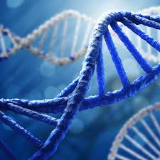
Chronic Inflammation impact on Body
Chronic inflammatory response can eventually start damaging healthy cells, tissues, and organs. Overtime this can lead to DNA damage, tissue death, and internal scarring
Cancer
Heart Disease
Stroke
Arthritis and Joint Diseases
Type 2 Diabetes
Chronic Obstructive Pulmonary Disease
Allergies
Obesity
Cognitive decline and dementia
Ioannidou A, Goulielmaki E, Garinis GA. DNA Damage: From Chronic Inflammation to Age-Related Deterioration. Front Genet. 2016 Oct 25;7:187. doi: 10.3389/fgene.2016.00187. PMID: 27826317; PMCID: PMC5078321.

Slide 10
Chronic inflammation – DNA Replication

Slide 11
Chronic Inflammation Risk Factors
Age
Obesity
Diet
Smoking
Low Sex Hormones
Stress and Sleep Disorders

Slide 12
Chronic inflammation management

Slide 13
Diet
Pro-Inflammatory
Anti-Inflammatory
(Academy of nutrition and dietetics)
Sugar and High-Fructose Corn Syrup
Artificial Trans Fats
French Fires
Fast Food
Margarines
Vegetable shortenings
Vegetable and Seed oils
Refined Carbohydrates
Candy
Cookies
Bread
Pasta
Processed Meat
Make Fruits and Vegetables Half Your Plate
Eat a variety of brightly colored vegetables and fruits
Be Smart about Protein
Five to six ounces equivalents per day for moderately active individuals
Select fatty fish containing omega-3s
Choose leaner protein foods, such as chicken and turkey or lean cuts of beef and pork
Choose Healthy Fats
Monounsaturated fats: olive, safflower, canola, peanut and avocado oils
Select Whole Grains
Whole grain flours and cereals, brown rice, quinoa, millet and wheat berries
Experiment with Fresh Herbs and Spices

Slide 14
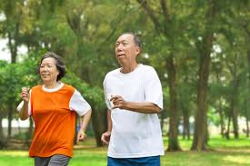
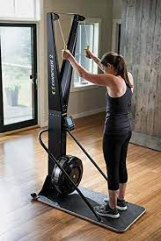
Aerobic Exercise

Slide 15
ACSM guidelines
Participation in regular aerobic exercise has been shown to have numerous beneficial effects resulting in an improved inflammatory profile and overall immune function in individuals suffering from chronic low-grad inflammation.
American College of Sports Medicine (ACSM) Recommendation
150-300 minutes/week of moderate aerobic exercise (65-75% maxHR)
75-150 minutes/week of high intensity aerobic exercise (76-96% maxHR)

Slide 16
Training Zones https://www.polar.com/blog/running-heart-rate-zones-basics/
Zone 5: Maximum (90-100% maxHR)
Zone 4: Hard (80-90% maxHR)
Zone 3: Moderate (70-80% max HR)
Zone 2: light (60-70% maxHR)
Zone 1: very light (50-60% maxHR)

Slide 17
Training Zones Energy
Zone 5: Maximum (carbohydrate shifting towards creatine phosphate)
Zone 4: Hard (carbohydrate metabolism)
Zone 3: Moderate (Fat shifting to carbohydrate metabolism)
Zone 2: light (60-70% Fat Metabolism)
Zone 1: very light (Fat Metabolism)

Slide 18
Training Zones
Zone 4
Energy used mainly: carbohydrate
Zone 2
Energy used mainly: fat
Body has available all the oxygen it needs

Slide 19
Energy Availability
1 gram of Fat = 9 Kcal
1 gram of carbohydrate = 4 Kcal

Slide 20
Zone 2 Training physiological Benefits
Increase in the number of mitochondria
Increase in mitochondrial efficiency
Increase in “metabolic flexibility”
Ability to utilize fat and glucose as energy source
Lower resting heart rate
A decrease in blood pressure
Improves insulin resistance
Luks, H. J. (2022, July 11). Zone 2 heart rate training for longevity and performance. Howard J. Luks, MD. Retrieved December 1, 2022, from https://www.howardluksmd.com/zone-2-hr-training-live-longer-less-injury/

Slide 21
Zone 2 Training Mitochondria
Powerhouse
Increases the number and efficiency of mitochondria in your body
Stimulate mitochondria to create the most ATP (energy)
Improve mitochondrial efficiency at burning FAT
Poorly functioning mitochondria or “mitochondrial dysfunction” is seen in people w/ heart disease, dementia, Type 2 diabetes, Metabolic Syndrome
Luks, H. J. (2022, July 11). Zone 2 heart rate training for longevity and performance. Howard J. Luks, MD. Retrieved December 1, 2022, from https://www.howardluksmd.com/zone-2-hr-training-live-longer-less-injury/
Notes:
Metabolic syndrome – 3 or more of the following – abdominal obesity, high blood pressure, impaired fasting blood glucose, high triglycericde levels, low HDL

Slide 22
Longevity Mitochondrial Health
Mitochondrial dysfunction has been reported to play a role in many human disease and disrupted mitochondrial function is a hall mark of aging
Bornstein R, Gonzalez B, Johnson SC. Mitochondrial pathways in human health and aging. Mitochondrion. 2020 Sep;54:72-84. doi: 10.1016/j.mito.2020.07.007. Epub 2020 Jul 30. PMID: 32738358; PMCID: PMC7508824.

Slide 23
Zone 2 training Cardiovascular Health
Improves Cardiovascular Health
Increased Stroke Volume
Increased vascularity enabling the more oxygenated blood to be delivered to the body
Lower Resting Heart Rate
Normal range – 60-100 beats per minute
Luks, H. J. (2022, July 11). Zone 2 heart rate training for longevity and performance. Howard J. Luks, MD. Retrieved December 1, 2022, from https://www.howardluksmd.com/zone-2-hr-training-live-longer-less-injury/

Slide 24
Zone 2 training Additional Benefits
Improves work capacity during exercise
Reduced risk of injury
Enhance recovery from injury and/or strenuous exercise
Enhanced mood, stress reliever

Slide 25
Math time!

Slide 26
Karvonen Formula
Target Heart Rate = ((max HR – resting HR) x %intensity) + resting HR
Age-predicted Maximum Heart Rate = 220 – Age

Slide 27
Karvonen Formula
Age: 45
Resting Heart Rate: 62 beats per minute
Age-predicted Maximum Heart Rate = 220 – 45 = 175 beats per minute
Target Heart Rate = ((max HR – resting HR) x %intensity) + resting HR
((175 – 62) x 60%) + 62 = 129 beats per minute
((175 – 62) x 70%) + 62 = 141 beats per minute

Slide 28
Cardio in a seated position
((175 – 62) x 60%) + 62 = 129 beats per minute
((175 – 62) x 70%) + 62 = 141 beats per minute
Subtract 10 beats per minute
((175 – 62) x 60%) + 62 = 129 -10 = 119 beats per minute
((175 – 62) x 70%) + 62 = 141 - 10 = 131 beats per minute

Slide 29
Zone 2 training
Target Heart Rate
60-70% of maxHR
Duration
45–90-minute sessions
Frequency
4-6x/week

Slide 30
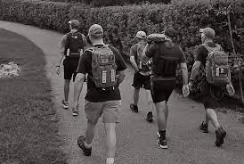
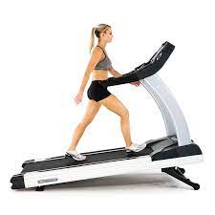
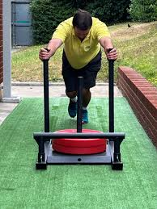
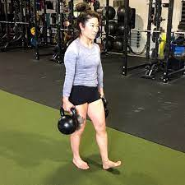
Modalities

Slide 31
Wrap Up
Cardiovascular disease
Chronic inflammation
Mitochondrial health and aging
Zone 2 Training
Recommendation 80% of training should be in Zone 2

Slide 32
Thank You For Your Time!
Christopher Fall LMT, CSCS, ACSM EP-C, CES
Health Science Specialist
Email – Christopher.j.Fall.civ@health.mil

